Slide 1
Precise Analysis

Slide 2
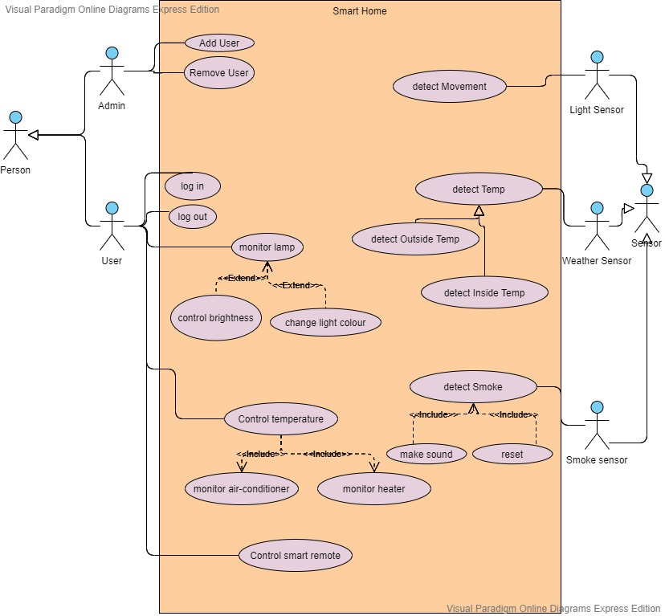
USE CASE DIAGRAM

Slide 3
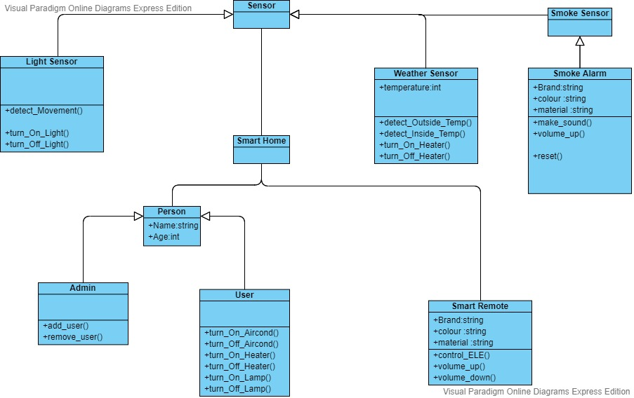
Class Diagram

Slide 4
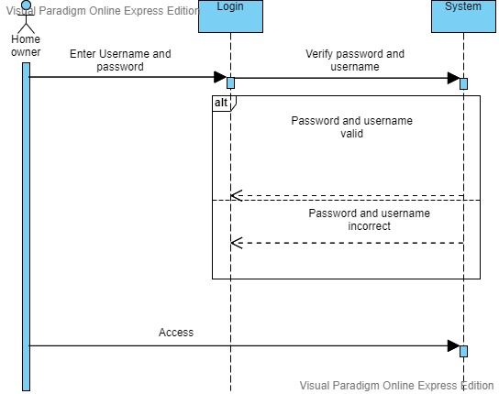
SEQUENCE DIAGRAM FOR LOGIN

Slide 5
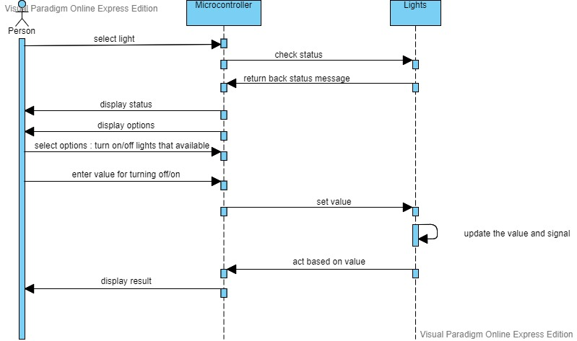
SEQUENCE DIAGRAM FOR CONTROLLING LIGHT

Slide 6
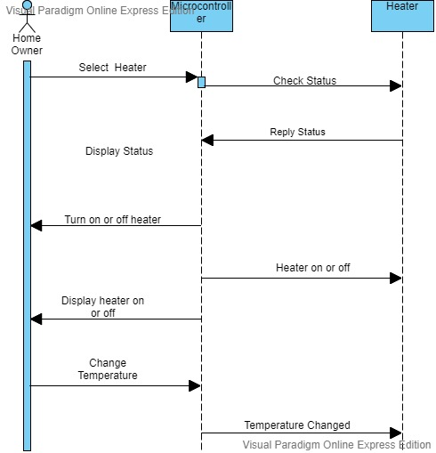
SEQUENCE DIAGRAM FOR HEATER

Slide 7
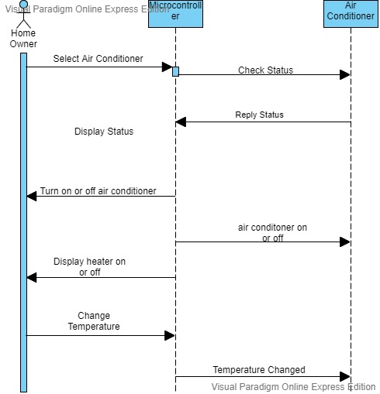
Sequence Diagram for Air Conditioner

Slide 8
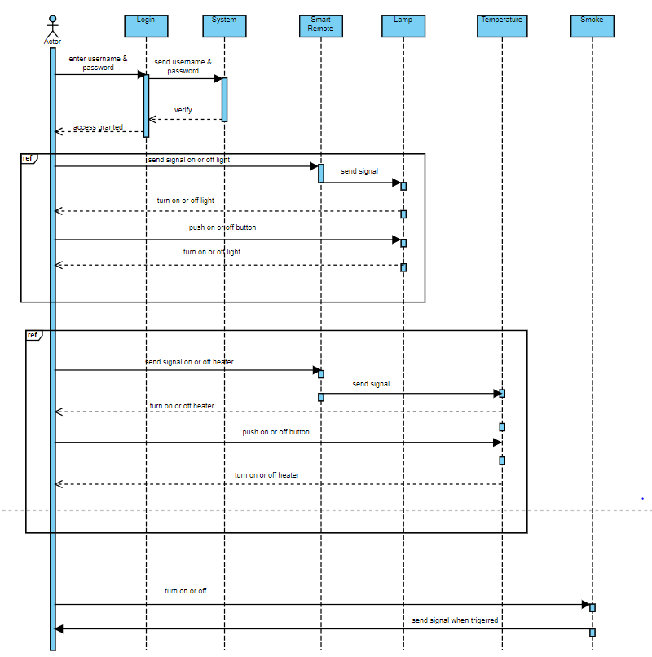
SEQEUNCE DIAGRAM FOR SMART REMOTE

Slide 9
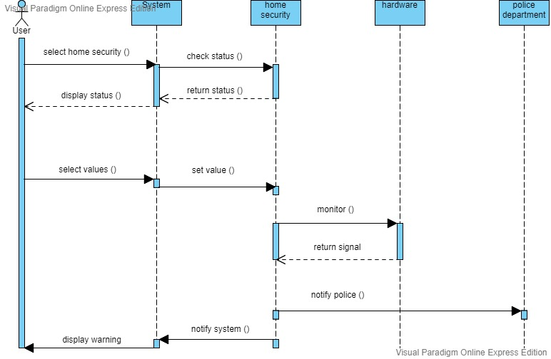
SEQUENCE DIAGRAM FOR SECURITY

Slide 10
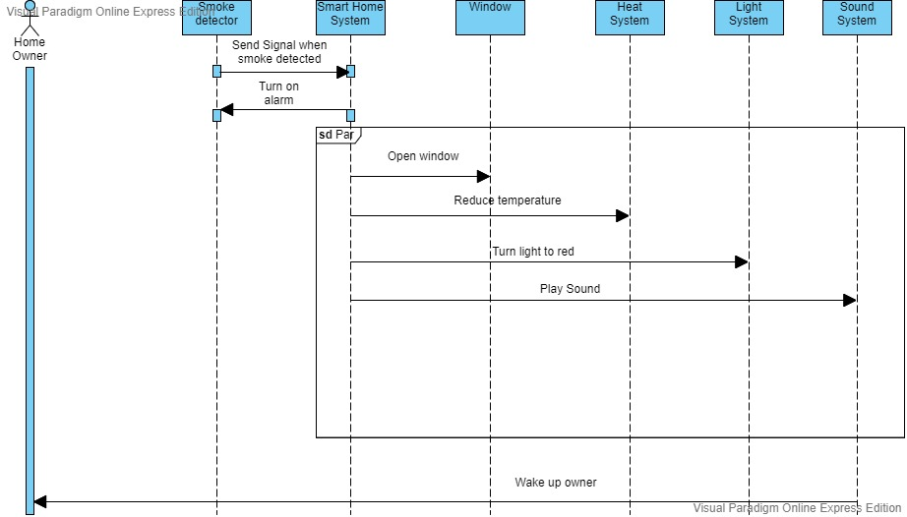
Sequence Diagram for Fire Alarm

Slide 11
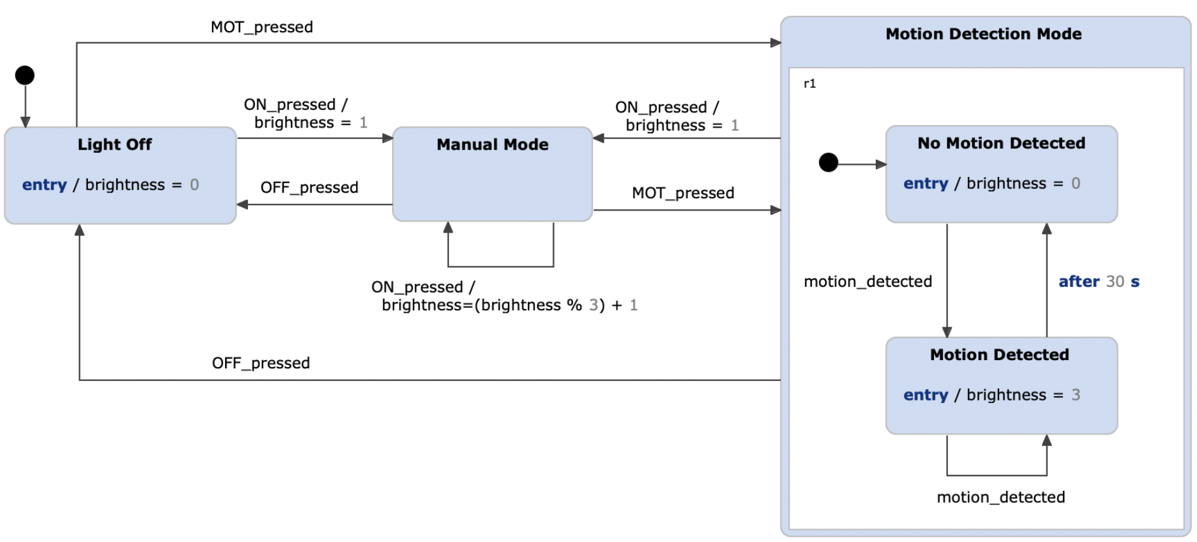
STATE DIAGRAM FOR LIGHT AND MOTION SENSOR

Slide 12
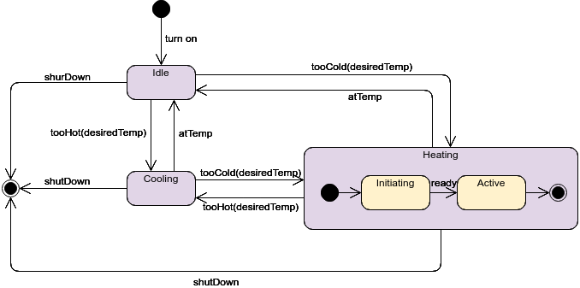
STATE DIAGRAM FOR HEATING/COOLING SYSTEM

Slide 13
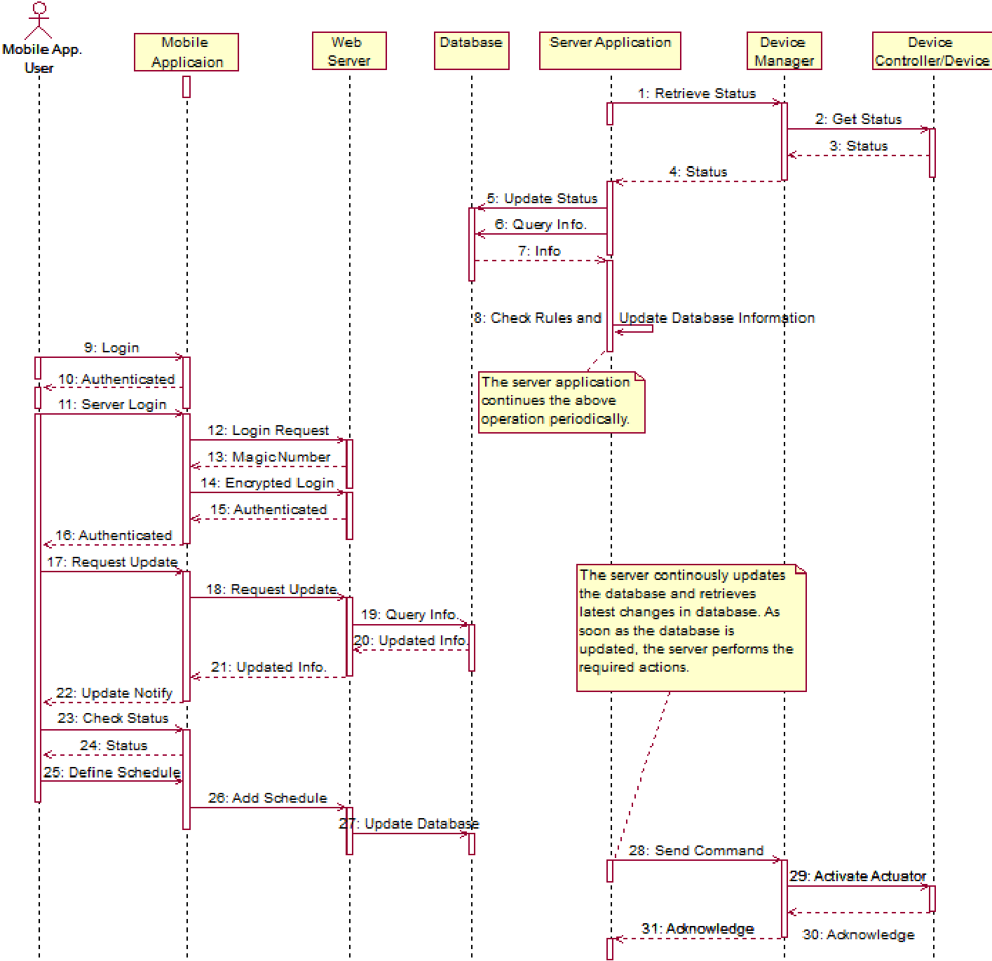
MORE GENERAL FORM

